Slide 1
Understand the core Azure Architectural components

Slide 2
Agenda
Azure regions
Availability zones
Azure Resource Manager (ARM)
Resource groups

Slide 3
Azure regions
Geographies: Boundaries created by Microsoft in order to provide Azure services to people around the world. There are often regulations for data handling that apply to an entire country, and having a geography defined for a country allows Microsoft to ensure that data-handling regulations are in place. Each geography contains at least two regions separated by a large physical distance is important. That’s how Azure maintains disaster recovery.
Region: At each region, Microsoft has built datacenters (physical buildings) that contain the physical hardware that Azure uses.
These datacenters contain climate-controlled buildings that house the server racks containing physical computer hardware. They also have:
Complex and reliable network infrastructure to provide the networking power.
Each datacenter has an isolated power supply and power generators in case of a power outage. All of the network traffic entering and exiting the datacenter goes over Microsoft’s own fiber-optic network, on fiber owned or leased by Microsoft. Even data that flows between regions across oceans travels over Microsoft’s fiber-optic cables that traverse the oceans.
Notes:
To ensure that data in Azure is safe from disasters and failures due to possible problems in a particular region, customers are encouraged to replicate data in multiple regions.
In order to ensure that applications are still performing as quickly as possible, Microsoft guarantees round-trip network performance of 2-milliseconds or less between regions.
When a customer is creating Azure resources, only the region is visible. The concept of geographies is an internal implementation of Azure that customers don’t really have visibility of when using Azure.

Slide 4
Agenda
Azure regions
Availability zones
Azure Resource Manager (ARM)
Resource groups

Slide 5
Availability zones
The fact that regions are physically separated by hundreds of miles protects Azure users from data-loss and application outages due to disasters at a particular region. However, it’s also important that data and applications maintain availability when a problem occurs at a particular datacenter within a region. For that reason, Microsoft developed availability zones.
There are at least three availability zones within each enabled region, and because each availability zone exists within its own datacenter in that region, each has a water supply, cooling system, network, and power supply that is isolated from other zones.
Because Availability zones are designed to offer enhanced availability for infrastructure, not all services support availability zones
Notes:
Availability zones aren’t available in all Azure regions. For the most up-to-date list of availability zone-enabled regions, see: https://docs.microsoft.com/azure/availability-zones/az-overview.
Availability zones provide high-availability and fault tolerance, but they may not help you with disaster recovery. If there is a localized disaster, such as a fire in a datacenter housing one zone, you will benefit from availability zones. Because availability zones are located in the same Azure region, if there is a large-scale natural disaster such as a tornado, you may not be protected. In other words, availability zones are just one facet to an overall disaster recovery and fault tolerant design.

Slide 6
Availability zones
As of right now, availability zones are supported with the following Azure services.
Windows Virtual Machines
Linux Virtual Machine
Virtual Machine Scale Sets
Managed Disks
Load Balancer
Public IP address
Zone-redundant storage
SQL Database
Event Hubs
Service Bus (Premium tier only)
VPN Gateway
ExpressRoute
Application Gateway (currently in preview)
App Service Environments (currently in preview in limited regions)
Notes:
You can keep up with all the news related to Azure updates by watching the Azure blog at https://azure.com/blog

Slide 7
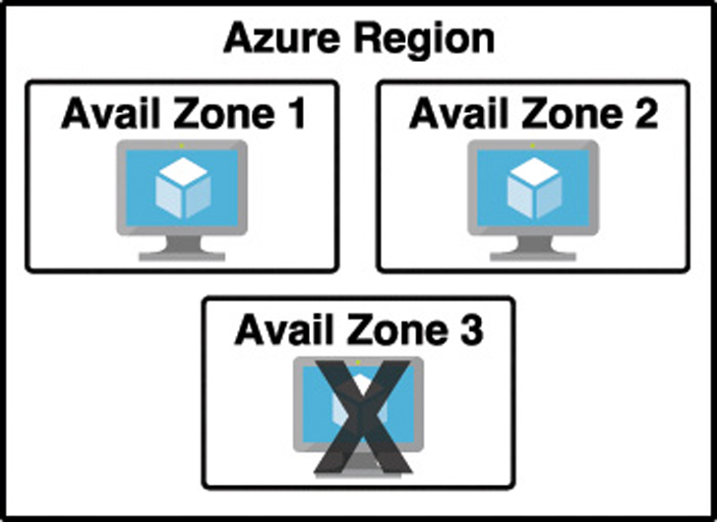
Availability zones
By deploying your service to two or more availability zones, you ensure the maximum availability for that resource. In fact, Microsoft guarantees a service level agreement (SLA) of 99.99% uptime for Azure Virtual Machines only if two or more VMs are deployed into two or more zones.
Don’t confuse availability zones with availability sets. Availability sets allow you to create two or more virtual machines in different physical server racks in an Azure datacenter. Microsoft guarantees a 99.95% SLA with an availability set.
An availability zone allows you to deploy two or more Azure services into two distinct datacenters within a region. Microsoft guarantees a 99.99% SLA with availability zones.

Slide 8
Availability zones
2 categories of services that support availability zones: zonal services and zone-redundant services
Zonal services are services such as virtual machines, managed disks used in a virtual machine, and public IP addresses used in virtual machines. In order to achieve high-availability, you must explicitly deploy zonal services into two or more zones.
Zone-redundant services are services such as zone-redundant storage and SQL Databases. To use availability zones with these services, you specify the option to make them zone-redundant when you create them. Azure takes care of the rest for you by replicating data to automatically multiple availability zones.

Slide 9
Azure Resource Manager (ARM)
ARM is a service that runs in Azure, and it’s responsible for all interaction with Azure services. When you create a new Azure service, ARM authenticates you to make sure you have the right access to create that resource, and then it talks to a resource provider for the service you’re creating.
Both the Azure portal and the command-line tools work by using ARM, and they interact with ARM using the ARM application programming interface, or API. The ARM API is the same whether you’re using the portal or command-line tools, and that means you get a consistent result

Slide 10
Agenda
Azure regions
Availability zones
Azure Resource Manager (ARM)
Resource groups

Slide 11
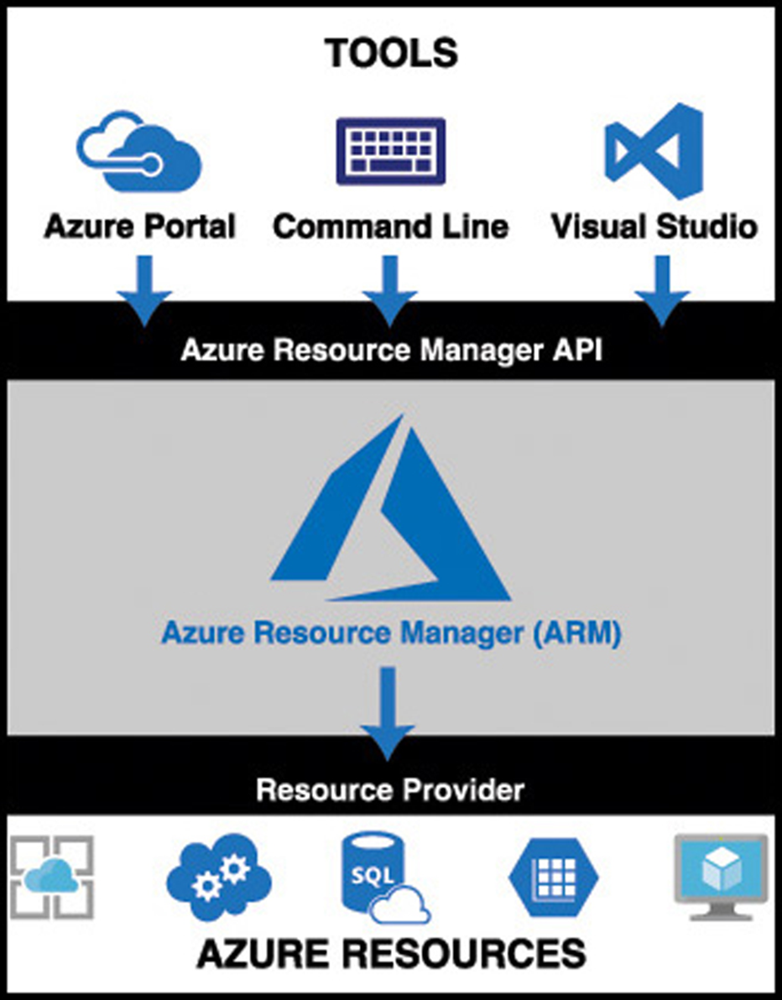
Azure Resource Manager (ARM)
The flow of a typical ARM request to create or manage a resource is straightforward. A tool such as the Azure portal, command-line tools, or Visual Studio makes a request to the ARM API.
The API passes that request to ARM where the user is authenticated and authorized to perform the action. ARM then passes the request to a resource provider, and the resource provider creates the new resource or modifies an existing resource.

Slide 12
Azure Resource Manager (ARM)
The request that is made to ARM isn’t a complicated, code-based request. Instead, ARM uses declarative syntax.
You tell ARM what you want to do and ARM does it for you. To do that, ARM uses files that are encoded in JavaScript Object Notation (or JSON) called ARM templates.
ARM has many benefits:
ARM allows you to easily deploy multiple Azure resources at once.
ARM makes it possible to reproduce any deployment with consistent results at any point in the future.
ARM allows you to create declarative templates for deployment instead of requiring you to write and maintain complex deployment scripts.
ARM makes it possible to set up dependencies so that your resources are deployed in the right order every time.
Notes:
ARM templates are incredibly powerful, but they’re also pretty simple. If you want to read more about how to use ARM templates, check out the documentation at: https://docs.microsoft.com/azure/azure-resource-manager/resource-group-authoring-templates.

Slide 13
Agenda
Azure regions
Availability zones
Azure Resource Manager (ARM)
Resource groups

Slide 14
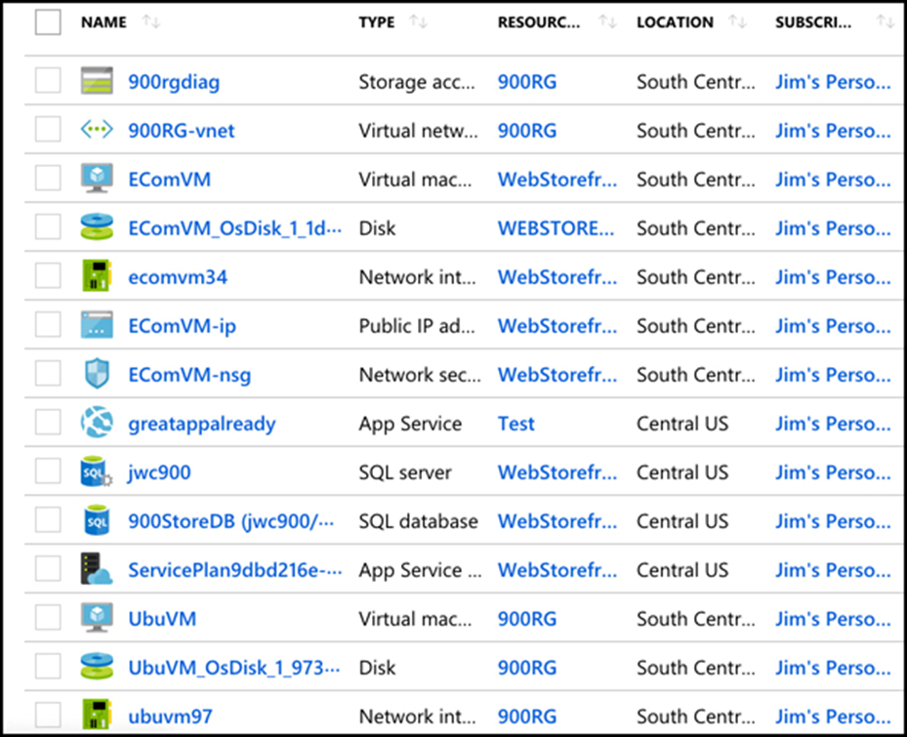
Resource groups
when you’re dealing with enterprise-level applications, you’re usually dealing with a complex array of services. Not only that, but you might be dealing with multiple applications that use multiple services, and they might be spread across multiple Azure regions.
A resource group is a logical container for Azure services. By creating all Azure services associated with a particular application in a single resource group, you can then deploy and manage all of those services as a single entity.
Organizing Azure resources in a resource group has many advantages.
First of all, you can easily set up deployments using an ARM template.
You can name a resource group with an easily-recognizable name so that you can see all Azure resources used in a particular application at a glance

Slide 15
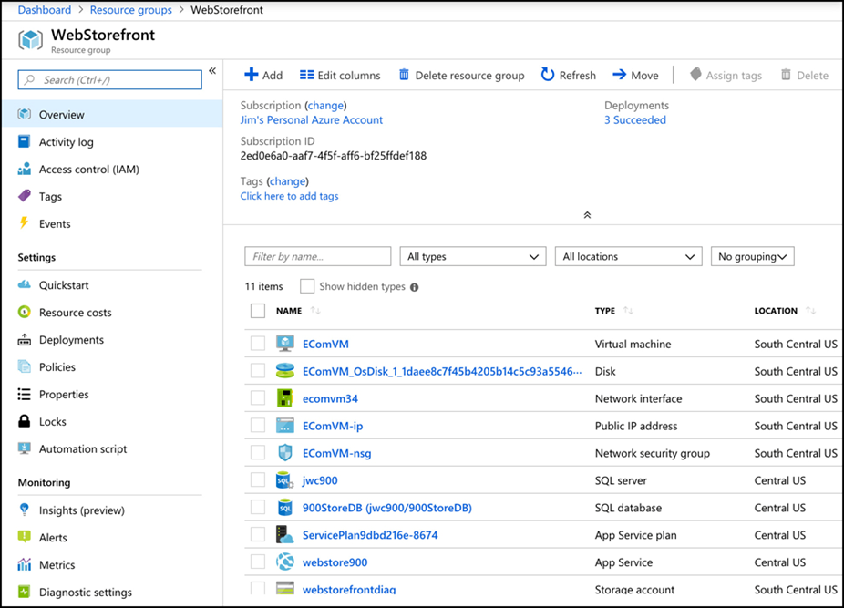
Resource groups
It’s convenient to see all of the resources associated with a particular app
In the figure, you see resources in several different Azure regions (Regions are in the Location column). If you have access to multiple Azure subscriptions, “you can also” have resources from multiple subscriptions in a single resource group.

Slide 16
Resource groups
A menu of operations that you can perform on your resource group.
If you click on Resource Costs, you can see the cost of all of the resources in this resource group. Having that information at your fingertips is especially helpful in situations where you want to make sure certain departments in your company are charged correctly for the used resources. In fact, some companies will create resource groups for each department rather than creating them scoped to applications.
An Azure resource can only exist in one resource group.
If you click on Tags, you can apply one or more tags that you choose to your resource group. A tag consists of a name and a value. You can apply a tag to most Azure resources, not just resource groups.
When you delete a resource group, all of the resources in that resource group are automatically deleted.

